Slide 1
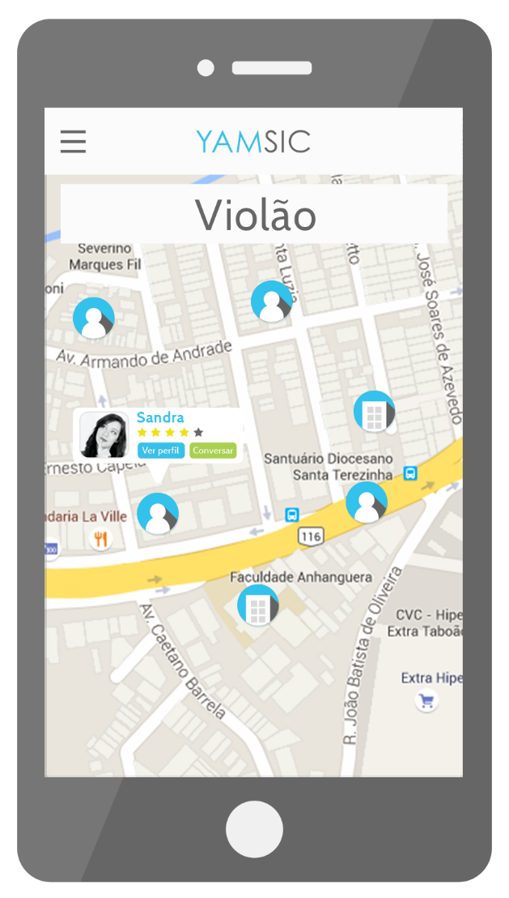


Slide 2
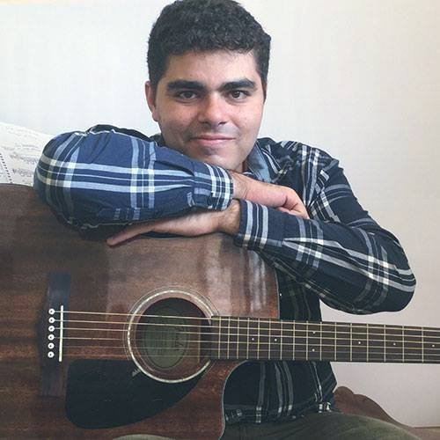
MEET THE YAMERS!
Henrique
Esdras
UX Designer
Marketing

Slide 3

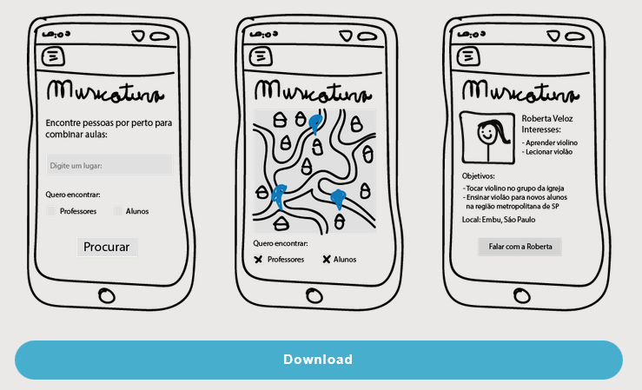
IN THE PREVIOUS EPISODE…
Value proposition: match
music students and
teachers based on their
locations.
Channels: Landing page,
Google and Facebook
ads, word of mouth,
and interviews.

Slide 4


THE TIMELINE SO FAR
BRAND AND
LANDING PAGE
Feb / 2016
LANDING PAGE
REDESIGN
May / 2016
BUSINESS
AND BRAND
REDESIGN
July – Now / 2016
INITIAL
CONCEPT
Jan / 2016
MARKETING
CAMPAIGNS
Apr - May / 2016
COACH AND
LESSONS LEARNED
Jun / 2016

Slide 5
NUMBERS FROM THE LAST CHAPTER
Facebook + Google: 60595 views and 460 clicks.
17 subscribers.
Most subscribers came from the Google Ad.

Slide 6



WHAT HAPPENED?
No clear message was sent to the target public.
No well defined unique value was proposed.
Not enough knowledge of the market.

Slide 7


LESSONS LEARNED
Most likes and subscribers are from women under 30 that
have some knowledge on the instrument of their choice.
Some of the teachers told that they find new students
based on recommendation from his / her students...
.... Which made us start to think how teachers manage to
engage students into making classes.

Slide 8
Great! Now that we have some experience
walking through a path that doesn’t work…
LETS PIVOT!

Slide 9



THE PAIN
No place for students to look at for music teacher
recommendations.
It’s hard for private music teachers to find new students.
Trust is a very important factor to consider when
searching for private classes.

Slide 10
THE SOLUTION
Introducing…
The only music education platform where you can find
the perfect network to start music classes!

Slide 11


THE MUSIC EDUCATIONAL PLATFORM
It all starts by downloading the app on the marketplaces.
Once you’ve downloaded, sign up to fill your profile.
Then you search for the name of one or more
instruments that you want to learn or teach.
And that’s it! Find a lot of cool people who’s
already teaching or learning the instrument!

Slide 12





HOW IT WORKS?
Set filters to refine
your search such as
location or skills.
Find the most
recommended and the
new folks’ profiles.
Log in to see the
full profiles and
start meeting people.
Schedule your
classes and start
learning or teaching!
Rate your class
experience on the
platform.
Receive shiny rewards
as you make progress
and recommend!

Slide 13




THE MARKET
* Source: SEBRAE. December 2015.
Education corresponds to 11% of
the music industry size in Brazil, one
of the top three major sectors. *
High level of informality thus not
having reliable information to
precisely measure the market. *
Lack of technical and professional
education, as well as innovation
on the business models. *
Lack of internal controls, marketing
and finance tools and information
systems. *

Slide 14


MARKET FIT
* Source: Agência Senado. March 2016.
People looking for their first time job as a music teacher.
Comply with the Brazilian law 13.278/2016, that requires
public schools to have music classes. *
Students that want to teach in order to help finance their
studies.

Slide 15



EXISTING SOLUTIONS
Musician social networks.
Facebook groups.
Word of mouth.
Music schools.

Slide 16





HOW TO MAKE MONEY?
* In app currency.
Percentage on each
transaction made on
the platform.
Advertising for teachers
and partners.
Buy note coins* to
unlock gamification
content.
Fee to recover your
status in case you lose
your class sequence.
Premium subscription
to access your full class
history and comparison.
Music tests to prove
abilities and get more
recommendations.

Slide 17


WHAT DO WE NEED?
At least one developer and one businessman on the
team.
Mentoring on entrepreneurship for startups.

Slide 19
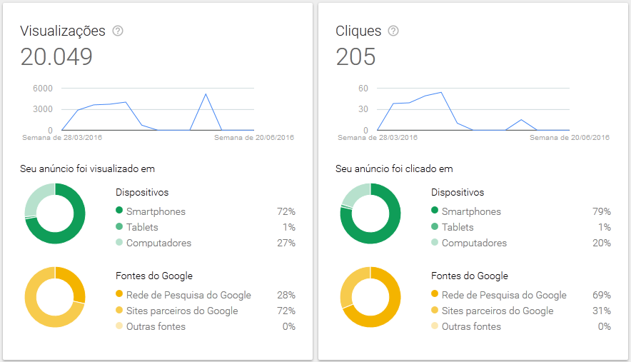

NUMBERS FROM THE LAST CHAPTER
Less than 1% of
clicks
Most clicks
through Google
search
Most people were
using smartphones

Slide 20
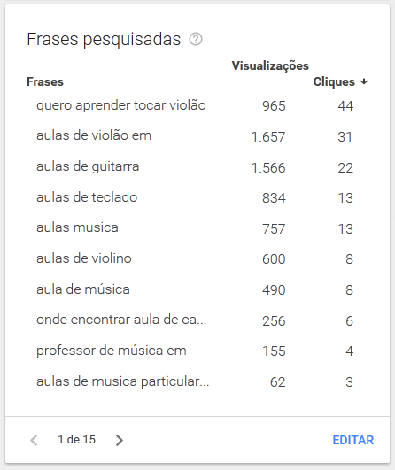
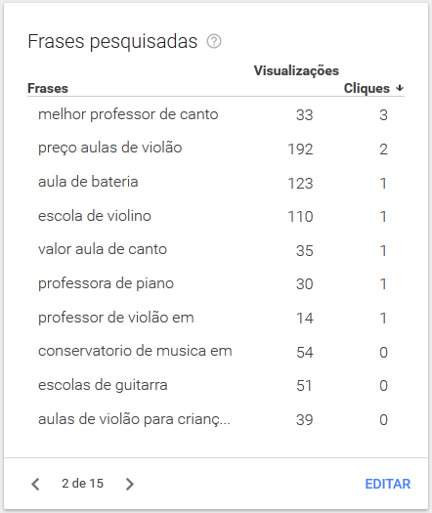
NUMBERS FROM THE LAST CHAPTER
Most viewed
Keyword was for
classes at specific
locations
Top searches for
playing the guitar,
keyboard, violin
and sing

Slide 21
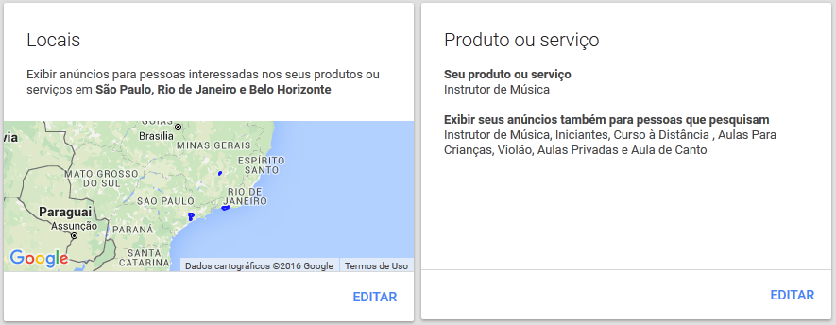
NUMBERS FROM THE LAST CHAPTER
The campaign
started at São
Paulo, Taboão da
Serra and Embu
das Artes
No clicks from
people in the
metropolitan area
of São Paulo.
Top amount of clicks from São Paulo,
Rio de Janeiro and Belo Horizonte.

Slide 22
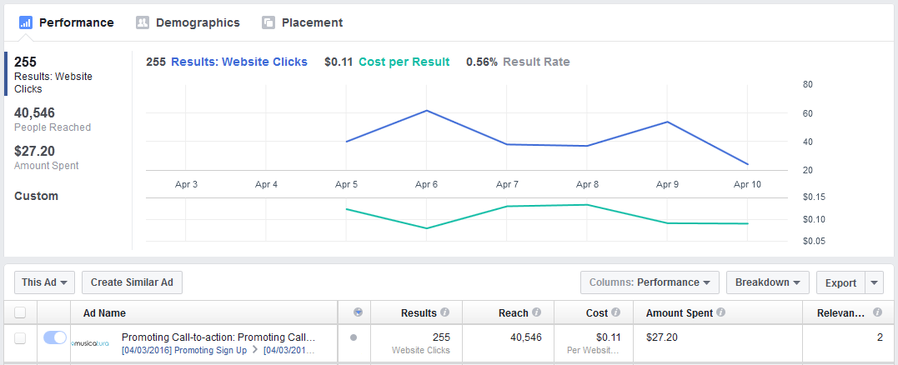
NUMBERS FROM THE LAST CHAPTER
40.546 people reached
255 clicks
Less than 2% of clicks

